Slide 1
Excelitte www.excelitte.com
Automatically convert thousands of spreadsheet data into a website application and can now be edited, new data added, viewed, analysed & manipulated.

Slide 2
What is Excelitte?
Converts thousands of records into a single document
Auto-converts data into a searchable, updateable, editable database
Easier analysis of your data in the form of chart & graphs
Notes:
Web application for spreadsheets allowing the user to convert thousands of records into a single document
Auto-converts data into a searchable, updateable, editable database
Easily analyses your data

Slide 3
Excelitte solves your data problems
Teams can work together, remotely, online via a shared database.
Real time updates to any changes or edits.
It keeps important records in one safe location.
Easily accessible by just you and your team wherever you are.
Notes:
Enables teams to work together, remotely, online via a shared database with real time updates to any changes or edits.
Allowing your team to always be on the same page with data and records.
It keeps all your businesses important documents in once safe location, that can be accessed by just you, anywhere you go.
The data is stored

Slide 4
Spreadsheets VS Excelitte - 1
Data is stored in spreadsheets in rows/columns, is subject to accidental deletion or transformation and when it runs into the hundreds or thousands it can be messy to manipulate.
Excelitte stores data in a database in a more organised manner to ensure that it is not repeated or duplicated, it is searchable, updateable, editable, from your web browser like Google Chrome or Firefox and allows for easier auto-analysis of your data.
With multiple people working on the same project, it is challenging to control different versions and have a master set of data.
Excelitte can handle any number of simultaneous user updates to the data in a controlled, very efficient manner ensuring only one version of data and a single source of truth is maintained.
With Excelitte, your data is accessible via a web browser and you can collaborate/work together with anyone else with no data corruption issues coming up. Accessing your data in Excelitte can be restricted to only your computer or accessed from other computers depending on your preference..
Spreadsheets are designed for a single user to store, small numbers of data and can be shared by several users across a network or by sending across by email but rather inefficiently.
There is a limit on how much data spreadsheets can store for example, Excel 2007 and older versions can only store 65,536 rows of data and 256 number of columns
Excelitte can store unlimited amounts of data, subject only to the disk space available on the host computer
Reports are captured in a grid form and charts can also be auto generated based on your choice of data fields. Excelitte also generates a 2D summary report also based on the user’s choice of data fields and an auto summation of all numerical data is automatically captured
Reports collected in a grid form and chart can also be generated by selecting whatever data fields are required.

Slide 5
Spreadsheets VS Excelitte - 2
Excelitte backs up all data weekly and sends it to you via email continuously
4 weeks’ worth of backup of your data is also available in the Excelitte apps dashboard and the backups are also spreadsheets files that can be uploaded back into Excelitte if you need to rebuild the computer hosting Excelitte
All updates to your data every week are 100% recoverable regardless of the circumstances
Spreadsheets can be saved on a computer but if the computer crashes or its rebuilt, your data stored in your spreadsheet could be lost forever.
No intelligent or predictive analysis can automatically be carried out on data unless exported into a more appropriate toolset.
Excelitte version 2 will be available in mid-2021 and will provide predictive analytics on any data stored using artificial intelligence & machine learning precepts.
We offer every potential user some degree consultancy to establish your exact requirements and recommend a specific package. We install Excelitte, make sure you are up and running, show how it easily navigate/use the application. You have a dedicated account manager who guides you through till Excelitte is all installed, and you have started deriving all the benefits.
Spreadsheets are normally available as part of bundled packages of software, normally installed by the user and no direct support from a person is offered or available.

Slide 6
Why Excelitte?
Excelitte consolidates, converts and migrates all your spreadsheet work sheet data into a database. Excelitte also provides a website front end to access, search and update the data.
Excelitte is customisable and we can add all other required features to suit your specific requirements.

Slide 7
Excelitte
Unlimited amount of data can be stored, retrieved, updated, and edited in an efficient & timely manner.
Also, accessible privately if required and the data held in Excelitte is exposed to a single user PC only.
Installed directly on your server or PC so the data is stored safely & securely.
Convert data from a spreadsheet to a database that can be retrieved from anywhere via the web.
Excelitte backs up your data weekly and sends you notification via email. The backups are also listed in the Excelitte dashboard.
Can handle any number of simultaneous user updates
Holds unlimited amount of data, subject only to the space of the host computer
Data updates are easily recoverable, in the event of a computer crash theft of device, accidental deletion of data.
Excelitte version 2, available mid-2021, provides predictive analytics on data stored
Notes:
Spreadsheet applications have a limit on how many data records a spreadsheet can hold, Excelitte allows unlimited recordings for large scale projects, allowing companies to grow with their customer base if need be.
Excelitte is designed for several users to be accessing the same data at any give time, for collaborative work or team projects. Excelitte allows teams to be sharing the same data from any PC Excelitte is installed on.
Data is a company’s most valuable asset. Excelitte allows unlimited data input, which is able to be retrieved, updated, and edited in an efficient and timely manner, benefitting the company immensely.
Unlike Excel, Excelitte is accessible from wherever you are, allowing your company to grow with the fast pace technical world – take your work with you wherever you go.
Excelitte can be installed directly on your computer – data and information are stored safely and securely on your computer or laptop.
With Excelitte you can convert data held in unlimited number of Excel Spreadsheets to now be stored, retrieved from a database accessible via a web based front end.

Slide 8
Excelitte Installation Process
Excelitte is presented and clients specific business needs are identified and discussed.
A subscription and Installation package is recommended and selected.
Any customised needs are identified and quoted for.
The Excelitte team writes up the invoice to be processed on the spot or email to client.
On receipt of payment an engineer will be in contact with you to arrange a time to install Excelitte, either in person or remotely.
Notes:
(Customer) Contacts us via the contact format at the bottom of our website enquiring about Excelitte.
Once you have selected the installation package, one of our representatives will contact you via email recommending a package level that is best suited for you/your company.
The Tems Team will email you the invoice
You pay
Using Calendarly, our representative will set up an appointment date and time that best suits you
Excelitte is then install on the arranged date with you remotely onto your PC (1 hour process)

Slide 9
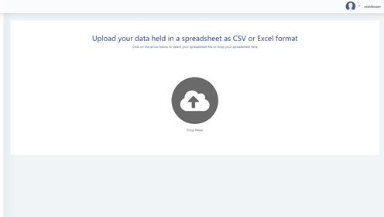
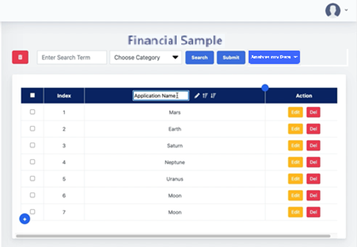
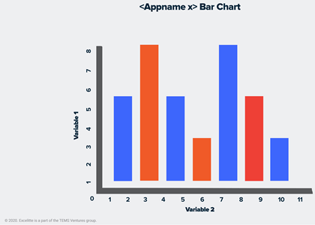
Technical High Level Features
Excelitte can be installed in the following manner:
On-Premise/Remote
Desktop Installation
Cloud/On-Premise/Remote
Server Installation
Quickly convert your Excel spreadsheet data into a database table using an intuitive drag-and-drop interface.
View, manage and analyse your table data all in one place.
Notes:
There are two ways that the application can be installed based on your preference: via desktop or server. After one of our support engineers installs Excelitte for the first time on your PC, you should be able to access the application by clicking the “Excelitte.url” shortcut. If installed on a server, however, you will be given instructions on how to navigate and connect to an IP address where the Excelitte application is based on. Once Excelitte is installed on your PC or Computer, you can now leverage the power of a database application and work even more productively, accurately, and securely with your data. With a simple drag and drop, you can effortlessly convert your Excel spreadsheet data into fully-fledged database tables with no technical knowledge required. Above all, our minimal user interface offers the tools you need to monitor, manage and analyse your table data without the headache of complex menu layouts.

Slide 10
Packages Available
Single User, Personal Computer – Single Installation and Database with unlimited spreadsheet data conversion.
Enterprise - Cloud or Data Centre Server (Single Installation) – Shared usage of the same data in one Database with unlimited spreadsheets data conversion.
Enterprise – Cloud or Data Centre Server, unlimited number of installations.
Notes:
Single User, Personal Computer – Single Installation, Single Database with unlimited number of spreadsheets converted into tables.
Enterprise - Single Installation on a Cloud or Data Centre Server – Shared usage of the same data in one Database instance with unlimited number of spreadsheets converted into tables.
Enterprise – Unlimited number of installations on any Cloud or Data Centre Server as required.

Slide 11
Support
One-Year Support Service Includes
Two complimentary call out's to remotely or physically re-install Excelitte if you rebuild your PC, Cloud or Data Centre Server or if Excelitte is just not working.
Unlimited Email Enquiry Support with a 72-hour response turnaround time.
We can customise Excelitte support to suit your specific needs, at additional costs.
Notes:
Single User, Personal Computer – Single Installation, Single Database with unlimited number of spreadsheets converted into tables.
Enterprise - Single Installation on a Cloud or Data Centre Server – Shared usage of the same data in one Database instance with unlimited number of spreadsheets converted into tables.
Enterprise – Unlimited number of installations on any Cloud or Data Centre Server as required.

Slide 12
Contact Us
Web
https://excelitte.com
Email
enquiries@excelitte.com
OR
Call +613892039 and ask for either Kimberley or Leah to start using Excelitte this week.

